Slide 1
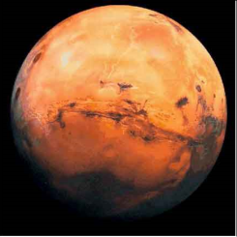
A Unified Space Vision
Buzz Aldrin
April 6, 2014

Slide 2
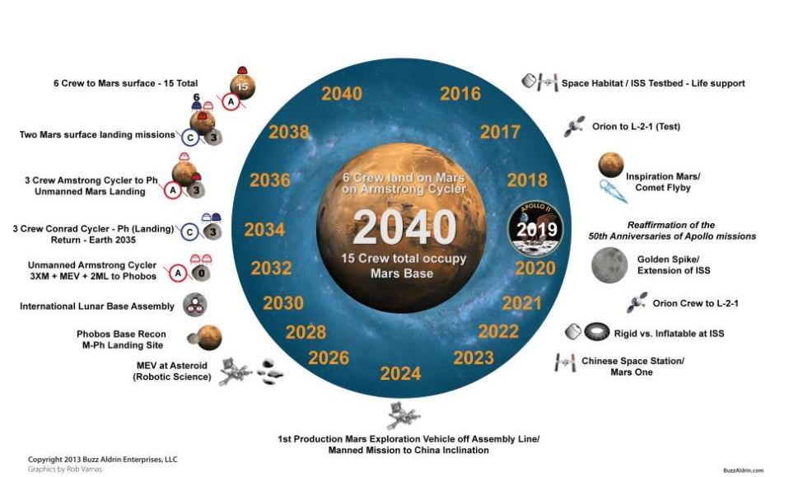
Unified Space Vision (U.S.) Civil Space Missions
Notes:
This is my Unified Space Vision chart with the suite of missions as I see them.
Chinese cooperation in international lunar development will be enhanced by participation in ISS and international activities at the Chinese station’s inclination at 42 degrees by re-inviting China’s participation in the ISS on the Apollo-Soyuz 40th anniversary to be celebrated July 2015.
Bring the nations together in an International Lunar Base Authority or Lunar Development Authority, patterned after Intelsat. Inflatable and rigid Exploration Module (EM) evaluated at 42 degrees – grows to support LEO fuel depot
US position at the moon to lead international lunar activities with two Mars spacecraft consisting of high and low propulsion – a node and exploration module - above the Moon’s surface at L1 and L2 for science and to develop commercial space (fuel depots and resources, especially H20) and to assemble the US designed evolutional international Lunar Operational Complex (LOC).
The Humans-to-Mars transportation systems by 2030. Replace human asteroid retrieval mission of 2021 with a dual robotic/human mission to an asteroid by 2025.
Planetary defense from space impacts to be US lead highest level of National Security of combined national and international capabilities (not a NASA mission).
Commercial resources should be investigated and developed first on the Moon before proceeding to asteroid resources.
Humans to Mars planned permanence from the first sortie to the surface, to a rather complete Mars Operation Complex (MOC) assembled from Phobos by international crews.

Slide 3
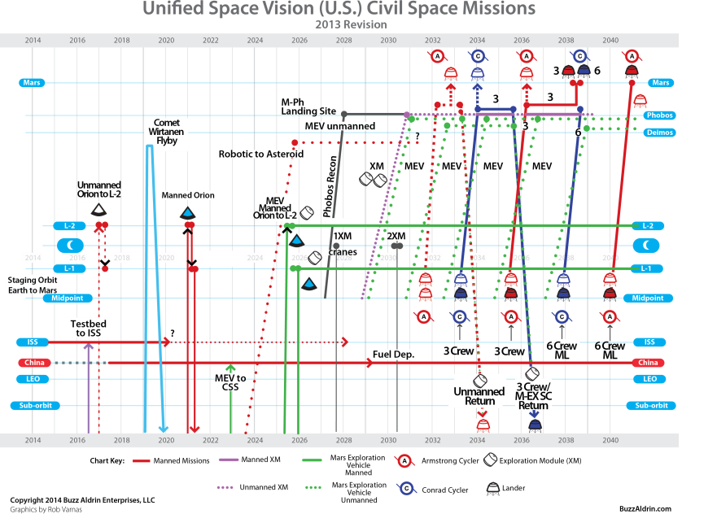
Unified Space Vision (U.S.) Civil Space Missions
Notes:
(Buzz will describe this chart)
This is my Unified Space Vision chart with the suite of missions as I see them.
US position at the moon to lead international lunar activities by from two Mars spacecraft above the Moon’s surface at L1 and L2 for science and to develop commercial space (fuel depots and resources, especially H20) and to assemble the international lunar base components.
Bring the nations together in an International Lunar Base Authority or Lunar Development Authority, patterned after Intelsat.
Chinese cooperation in international lunar development will be enhanced by participation in ISS and international activities at the Chinese station’s inclination at 42 degrees.
Humans-to-Mars transportation systems by 2030, to replace human asteroid mission of 2025.
Planetary defense from space impacts to be US lead of combined national and international capabilities (not a NASA mission).
Commercial resources should be investigated and developed first on the Moon before proceeding to asteroid resources.
Apollo-Soyuz 40th anniversary to be celebrated July 2015 by re-inviting China’s participation in the ISS.
I will have updates on my website soon at www.buzzaldrin.com. As new technologies emerge we will try to keep our site up to date. Also, don’t forget to follow me on Twitter @theRealBuzz. If you’re interested in learning more go to my website and click on SPACE VISION.

Slide 4
1 VS. 2 Synodic Periods
Illustration by Blake Rogers from

Slide 5
Radial Distance Plot – 2 Synodic Period
Illustration by Blake Rogers from
Notes:
Radial Distance Plot
In this radial distance plot, the blue line represents the distance between the Sun and the Earth at 1 Astronomical Unit (AU). The red line represents the distance from the Sun to Mars at 1.52 AU. The cycler vehicle ferries back-and-forth between Earth and Mars. The solid green line indicates where crew 1A boards the cycler vehicle at Earth-1 (E1, green circle) and disembarks at Mars-2 (M2, red circle). (Here we note that the only opportunities to board or disembark from the cyclers are marked by green or red circles.) The solid black curve indicates where the cycler vehicle continues (unoccupied) to Earth gravity assists at E3 and E4. The gravity assist at E4 duplicates conditions at E1 (but 4 2/7 years later) so that crew 2A can reuse the cycler vehicle (as indicated by the second solid green line) to board at E4 and disembark at M5. The dashed green and black curve represents the path a second cycler vehicle could take to allow for crews to be sent to Mars at every possible opportunity (namely every Earth-Mars synodic period of 2 1/7 years). Not labeled on the dashed curve are crew 1B, 2B, and 3B encounters (i.e. where these crews board and disembark). The vertical, orange line is the time at which the Earth and Mars are at opposition (i.e. 180° apart) and occurs once every synodic period. (Courtesy of doctoral student, Mr. Blake Rogers, and Professor Jim Longuski, Purdue University.)

Slide 6
Purdue Aldrin 2 Synodic Period Cycler
(Aldrin Cycler Added)
Illustration by Blake Rogers from
Notes:
This is a comparison radial distance plot chart, again with help from Purdue, comparing my original Aldrin Cycler concept compared to the one that has been refined by Purdue. In the next chart we’ll show a close up version of Purdue’s update and I’ll explain it in more detail.

Slide 7
2 Synodic Period Cycler Video
Notes:
Back in the early 1980’s, I began to apply my orbital rendezvous expertise to a lunar spacecraft system that would perform perpetual cycling orbits between the Earth and the Moon. Central to the idea is using the relative gravitational forces of the Earth and Moon to sustain the orbit, thereby expending very little fuel. This is called gravity assist. But there was a catch. The approach took longer to get to the Moon this way. For such a short distance, a four-day trip using cycling orbits was not sufficiently advantageous.
It was my good friend, Tom Paine, a former NASA Administrator during a number of the Apollo program expeditions, including mine, who urged me to adapt the cycling orbit concept to the much more intricate goal of supporting human missions to Mars. And lo and behold, it works.
Now, what has helped even more is that Professor Jim Longuski has actually been very supportive and interested in cycling orbits and he and some of his students are helping me to develop this concept into an even better idea than I originally conceived. Here you’ll see an animation that was created by Blake Rogers who is a PhD candidate and who has been an integral part of the most recent developments. Let me show you how this works.

Slide 8
Aldrin Mars Cycler
Notes:
What does the Aldrin Cycler look like? This video animation was created by the guys who developed my new video game to give you a basic idea of what the Aldrin cycler could look like. It will probably change as new technologies evolve but this is the first stab at it. Since this video was created I’ve made changes already.

Slide 9
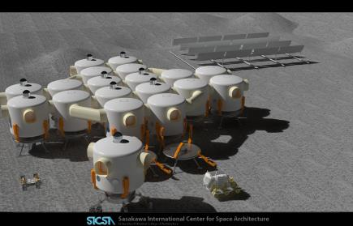
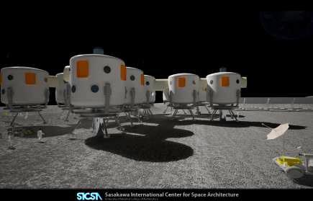
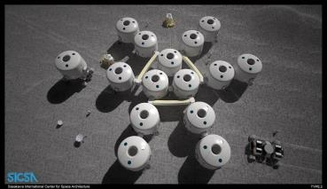
Lunar Operations Complex
Notes:
I think that the most significant departure I take from the current architecture is to remove the emphasis on getting back to the Moon. We have already blazed the trail to this destination. It is time for commercial and international interests to move beyond discovery to development.
Other nations are developing the capability to explore and develop the Moon with robots and eventually crews
Providing support for international lunar development is in our best interest
By participating in an international program, we
Avoid a race back to the Moon
Facilitate long-term international cooperation
This approach retains our ability to participate in lunar science, exploitation and development by other US government (NSF, etc) and commercial entities. It may well be that NASA is not best suited to run this program. Exploitation has never been its strongpoint. We should carefully consider when and how lunar development transitions to other commercial interests and to US government agencies more adept at identifying and exploiting scientific opportunities.

Slide 10
Lunar Base – 3 Unit Core
Core Module
Expansion Module
ISRO
+ S.K.
CSA + R
ESA + JAXA
Notes:
Buzz will describe the configuration of his lunar base design

